Slide 1

SHREE RAMSWAROOP MEMORIAL UNIVERSITY
Assignment:-3
Java Enterprise Edition Lab - 03
Submitted to:
Submitted by:
Vidushi Srivastava
Mukesh Prajapati
Btech (Cse Industry integrated)
Roll No – 202410101230007

Slide 2
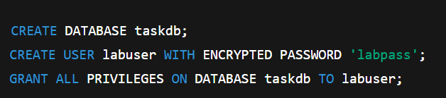
Step 1: Database Setup
A PostgreSQL database named taskdb was created, and a user named labuser was given access.

Slide 3
Step 2: Configure the Persistence Unit
The persistence configuration is written inside the persistence.xml file located in the META-INF folder.
<persistence xmlns="http://xmlns.jcp.org/xml/ns/persistence" version="2.2">
<persistence-unit name="taskManagementPU">
<class>com.taskiteasy.entity.Task</class>
<class>com.taskiteasy.entity.User</class>
<class>com.taskiteasy.entity.Category</class>
<properties>
<property name="javax.persistence.jdbc.url" value="jdbc:postgresql://localhost:5432/taskdb"/>
<property name="javax.persistence.jdbc.user" value="labuser"/>
<property name="javax.persistence.jdbc.password" value="labpass"/>
<property name="javax.persistence.jdbc.driver" value="org.postgresql.Driver"/>
<property name="javax.persistence.schema-generation.database.action" value="update"/>
</properties>
</persistence-unit>
</persistence>

Slide 4
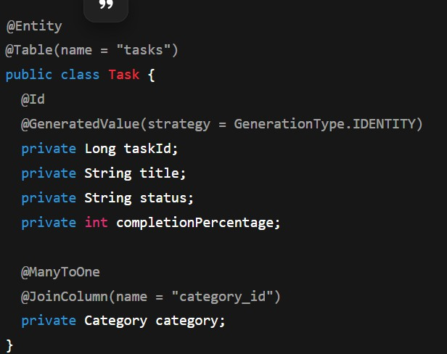
Step 3: Create Entity Classes

Slide 5
Step 4: Testing the Configuration
A Java program was written to persist and retrieve data using JPA.
EntityManagerFactory emf =
Persistence.createEntityManagerFactory("taskManagementPU");
EntityManager em = emf.createEntityManager(); em.getTransaction().begin();
Category category = new Category(); category.setName("Development"); em.persist(category);
Task task = new Task();
task.setTitle("Design Database Schema"); task.setCategory(category);
task.setStatus("Open");
task.setCompletionPercentage(0); em.persist(task);
em.getTransaction().commit(); em.close();

Slide 6
Step 5: Database Verification
After running the test, the data appeared in the database as shown below:
taskid title
status completionpercentage category_id
1 Design Database Schema Open 0 1

